Slide 1
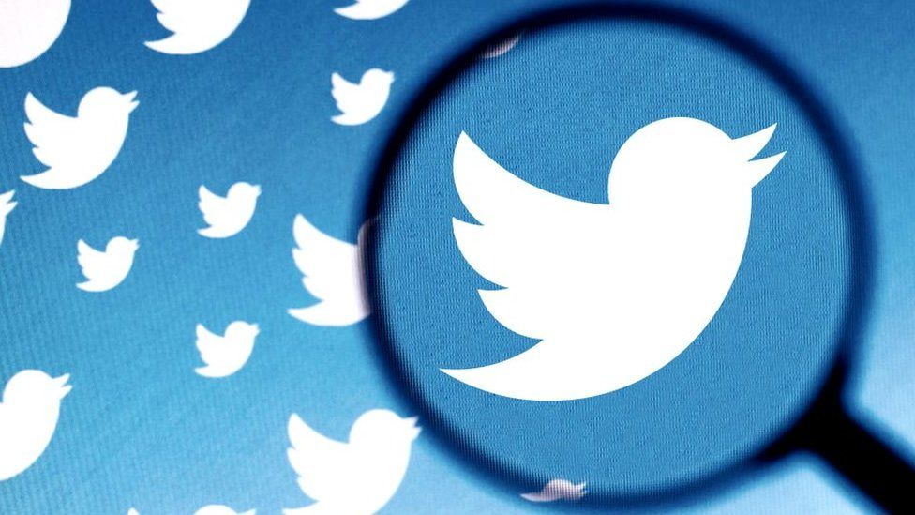
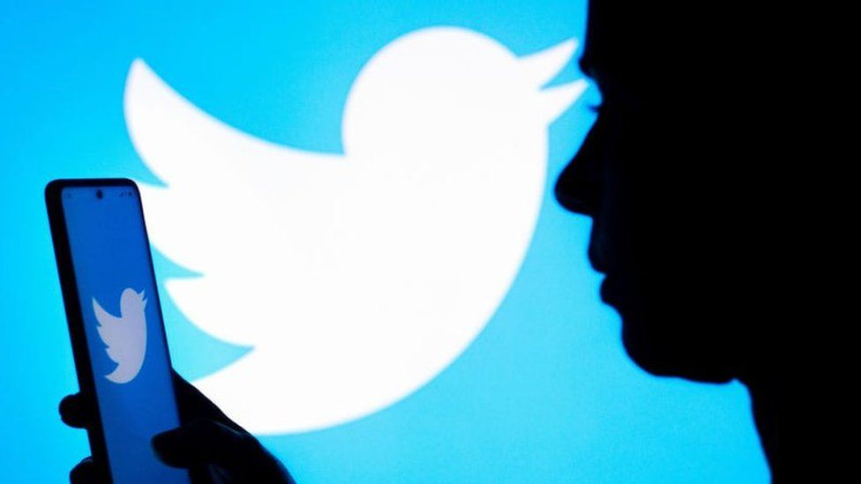
Tweet Topic Modeling
Unsupervised Machine Learning on one of Twitter’s Largest Datasets

Slide 2


Database
Sentiment140 Twitter dataset
1,600,000 tweets made between April 17 - May 27, 2009
Motivation
Seeking patterns in massive unlabeled dataset
Future applications: can be applied to other clustering models or ultimately a recommendation system
Notes:
40 days, split into 4 groups.
Average of 40,000 tweets per day
categorized sentiment removed for generic topic modeling
See how these tools can make sense of a seemingly insurmountable amount of data
Time capsule of simpler time

Slide 3
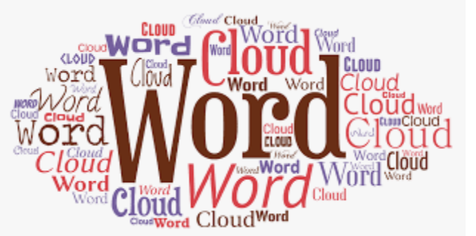





Overview
Tools & Stages
Steps
1
2
3
4
Visualizations
Topic modeling
Customizing stop words, extracting noun phrases
Pre-processing data; dividing into manageable sizes
Notes:
NLTK for stemming. Put in many stop words, still had to use textblob. Used TextBlob for both nouns & noun_phrases; went with the latter because it was more specific. This dataset has a lot of filler words.
Skilearn: Cross Vectorization & NMF for initial topic modeling, CoreX for training data to selected topics
WordCLoud to visualize CoreX's top tweets per category

Slide 4
Initial Topics with Non-Negative Matrix Factorization
First 400K tweets, after experimenting with topic counts and minimum/maximum word appearances
Notes:
Used CountVectorizer

Slide 5

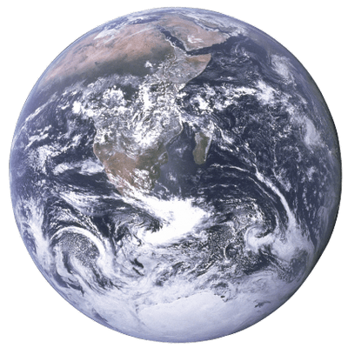
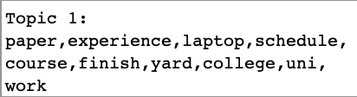
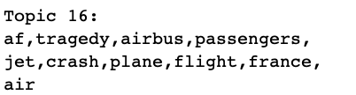
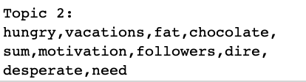
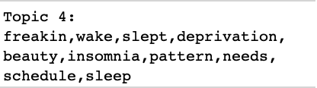
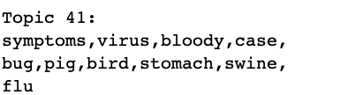
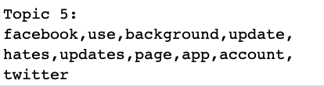
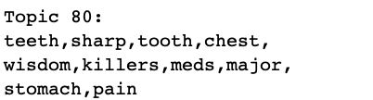
World & Personal News
Select Groupings from Unsupervised Machine Learning
Notes:
Machine learning identified large world events & picked up that complaints take up 3/5 of the top 5 topics.
Wisdom teeth were #80!

Slide 6

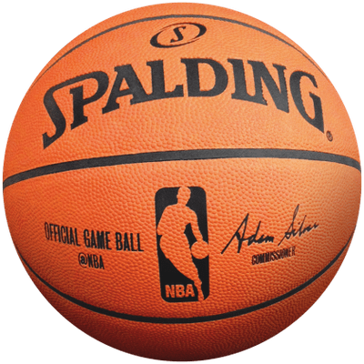
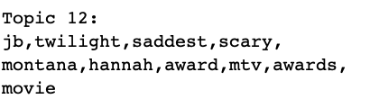
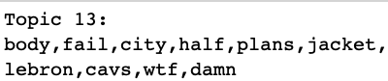
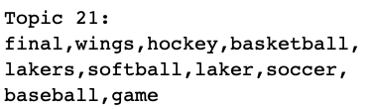
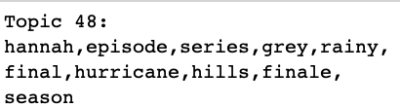
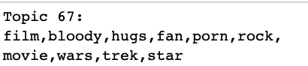
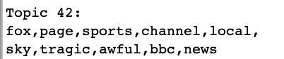
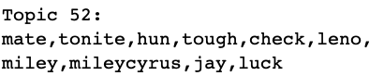
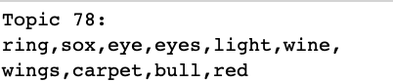
Pop Culture & Sports
Select Groupings from Unsupervised Machine Learning
Sports
Notes:
Around March Madness – a lot of tweets about Lebron, Lakers, Cavs
Miley Cyrus in ¾ of biggest pop culture topics

Slide 7

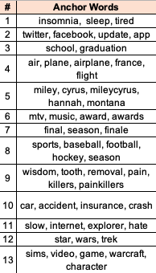
Forcing Topics with CorEx
13 Anchored Topics
1.
Fit Tweets to one of 13 anchored topics
2.
3
Created true/false dataframe to visualize topic popularity over time
Find tweets with highest topic correlations
4
Visualize words most correlated tweets with WordCloud

Slide 8
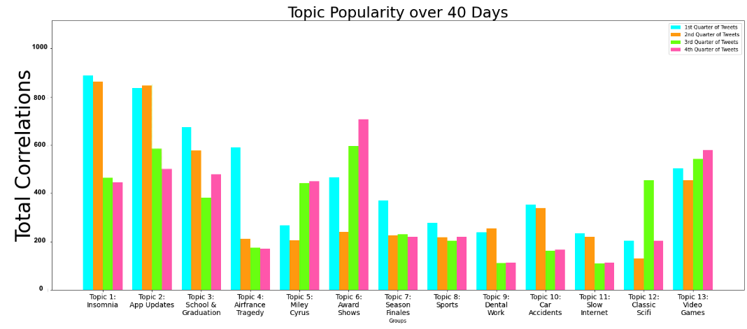
Notes:
Some topics shifted; for example, Jonas Brothers & Demi Lovato were more popular in later weeks than Miley cyrus, though she maintained popularity

Slide 9
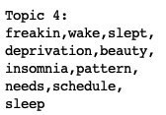
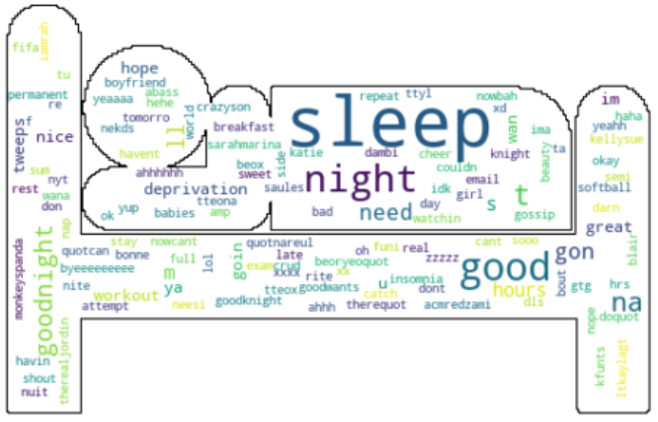
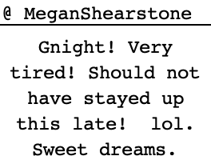
Anchor 1: Sleep Deprivation
CorEx Top Tweet
Notes:
Lot of noise; fifa & babies

Slide 10
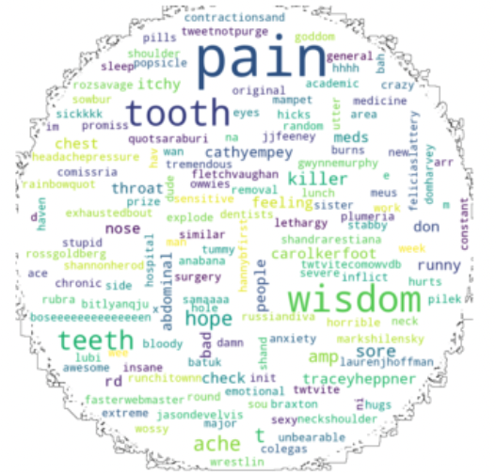
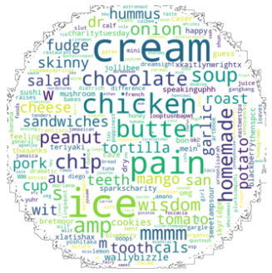
Anchor 8: Wisdom Teeth
First 10 days
Last 10 days
Text Here
You can simply impress your audience and add a unique zing and appeal to your Presentations.
Notes:
Might be confusing teeth & post-surgery foods with other tweets about food, or people with this issue are tweeting about food

Slide 11
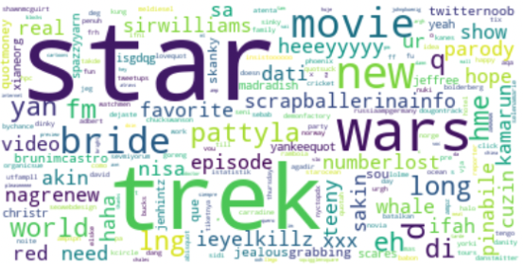
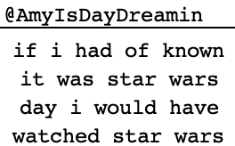
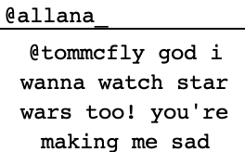
Anchor 11: Star Wars/Trek
CorEx Top Tweets
Notes:
Usernames that made it in the top 100 terms might be good for ad-targeting and/or promotions.

Slide 12


Findings
Future Applications
NMF was able to detect noteworthy patterns topics
Sifted through hundreds of thousands of documents
Regarding both personal & public affairs
Trained CorEx model found relatable content
Experiment with K-means clustering for more visualizations & scoring
Implement LDA
Apply fitted models to:
See how they work on other datasets, and
ultimately a recommendation system

